Slide 1


GROUP CODE · SURGE 090
INSTITUTION
Indian Institute of Technology, Delhi
Progress Review (Design & Development)
PROJECT GUIDE
Professor Amartansh Dubey
Smart Snake Robot
with Dynamixel Smart Servo Motors
Shashank Jangir
Bhavesh Bansiwal
Mahima Chotiya
ENTRY NO.
ENTRY NO.
ENTRY NO.
2024EE11048
2024ME10487
2024ME11187
PROJECT REPOSITORY
https://github.com/shashankjangir/SurGe-090-Smart-snake-robot
Notes:
Title slide for the 25% progress review of the Smart Snake Robot project, Group SURGE 090. Introduce the team and milestone scope.

Slide 2
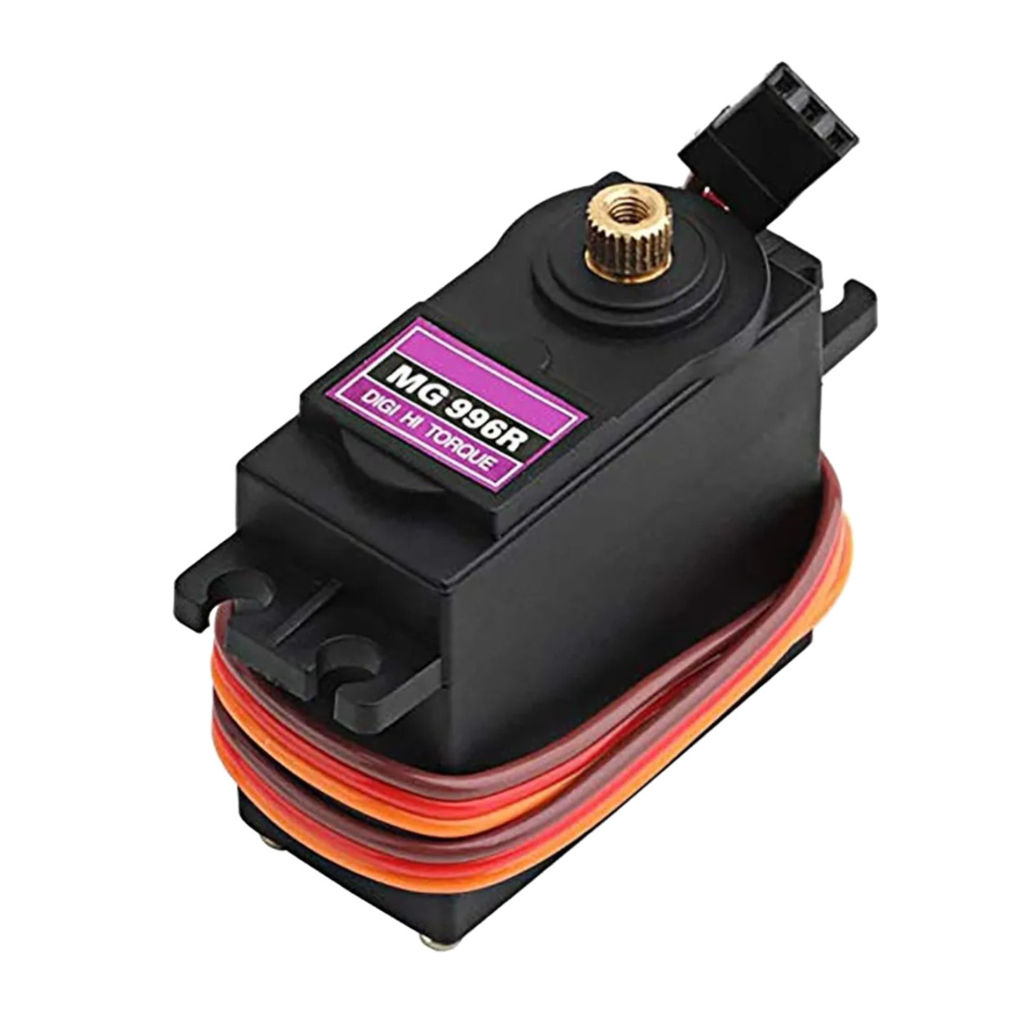
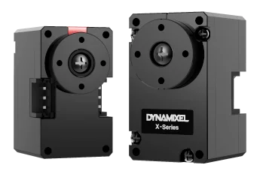
ACTUATOR SELECTION STUDY
Why Dynamixel Motors?
OPTIONS COMPARED
THE REQUIREMENT
Criterion | Conventional Servo | Dynamixel Smart Servo
Communication | Individual signal wire per motor | Daisy-chain communication
Wiring Complexity | High | Low
Feedback | Not available | Position, load, temperature, voltage feedback
Controller | External controller required | Built-in controller
Scalability | Difficult for many joints | Designed for multi-joint robots
Precision | Moderate | High
Robotics Applications | Hobby projects | Research and industrial robotics
A snake robot drives many joints at once. The actuator must deliver:
Precise position control
Simple wiring architecture
Scalability for multiple joints
Reliable communication
Real-time feedback
Compact size & sufficient torque

Slide 3
ARCHITECTURE & DECISION
Daisy-Chain Architecture & Final Selection
Conventional Servo — Separate Wiring
Dynamixel — Daisy-Chain
Servo 1
Controller
Servo 2
Servo 3
Ctrl
M1
M2
M3
M4
Servo 4
Every motor needs its own signal wire back to the controller.
One cable carries power and data to every joint in sequence.
KEY LEARNINGS
FINAL SELECTED ACTUATOR
Daisy-chain wiring sharply cuts cabling and assembly effort.
A controller built into every motor simplifies integration.
Real-time feedback enables future closed-loop control.
Compact form factor suits modular robot segments.
High precision and smart control fit advanced robotics.
Dynamixel XL330 Series
Chosen for its smart serial communication, full-state feedback, compact form factor and effortless multi-joint scaling — the right fit for a multi-segment snake robot.

Slide 4






GOALS & EXPECTED OUTCOMES
What This Project Sets Out to Build
01
02
03
Modular Architecture
Dynamixel Actuators
Raspberry Pi Control
A repeatable segment-based mechanical design.
Integrate smart servos with daisy-chained control.
A single-board-computer control system.
04
05
06
Locomotion Algorithms
Sensor Integration
Scalable Platform
Implement serpentine and gait-based motion.
Add sensing for future intelligent navigation.
Keep it maintainable and easy to extend.
Notes:
Six concrete goals across mechanics, actuation, computing, control, sensing and scalability. These map to the timeline phases.

Slide 5

WORK COMPLETED SO FAR
Quarter-One Progress Summary
COMPLETED TASKS
OVERALL COMPLETION(till now)
Literature review & project understanding
Raspberry Pi setup & configuration
25 %
Hardware selection & BOM preparation
Wi-Fi connectivity testing on the Pi
CAD design of snake-robot segment
Basic Raspberry Pi lab projects executed
Phase 1 complete · Phase 2 underway
Assembly sized to Dynamixel XL330 dims
GitHub repository created & maintained
10
2
1
Tasks done
Segments printed
Pi configured
3D printing of two prototype segments
Procurement process initiated
Notes:
About a quarter done: ten tasks closed across research, mechanical design, fabrication and the compute platform.

Slide 6
SYSTEM ARCHITECTURE
Conceptual Block Diagram
Architecture finalized · Implementation in progress
Power Supply
FUTURE INTEGRATION
IMU / Force Sensors
Raspberry Pi 5 [Central Controller]
Control Algorithms
Camera Module
Wireless Control Module
Communication Layer (U2D2 / UART)
Dynamixel Motor Network
Robot Segments (10 × servo joints)
LEGEND
Implemented
In Progress
Planned Future Work
Current Implementation Status
Raspberry Pi 5 configured and tested
Mechanical segments fabricated
Communication architecture defined
Dynamixel integration pending hardware
Notes:
Controller at the centre. Solid cyan = implemented/in progress; dashed amber (sensors, camera) = designed-in but scheduled for a later phase.

Slide 7

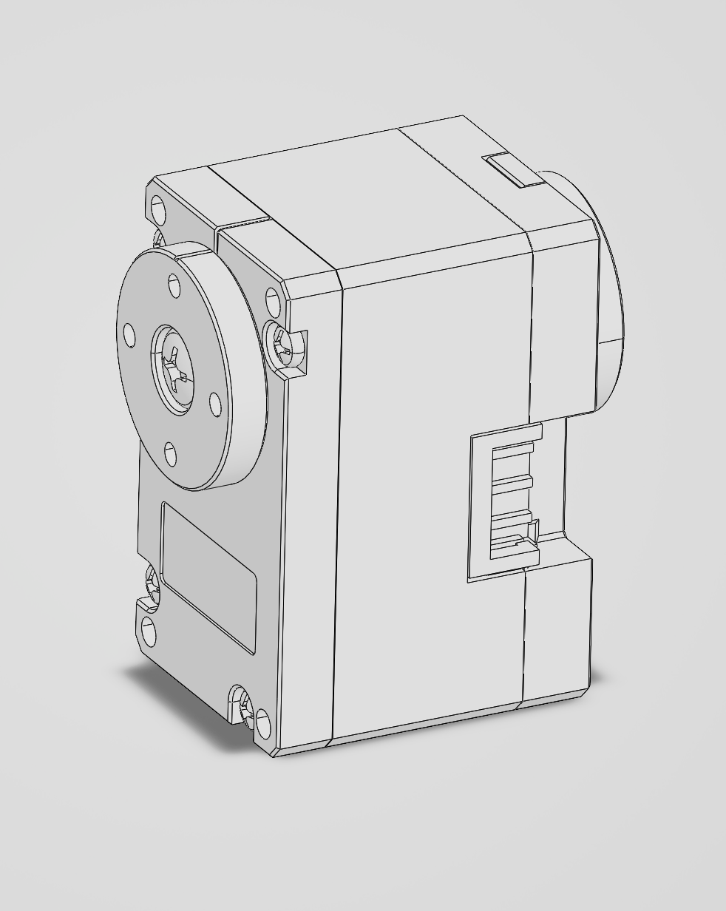
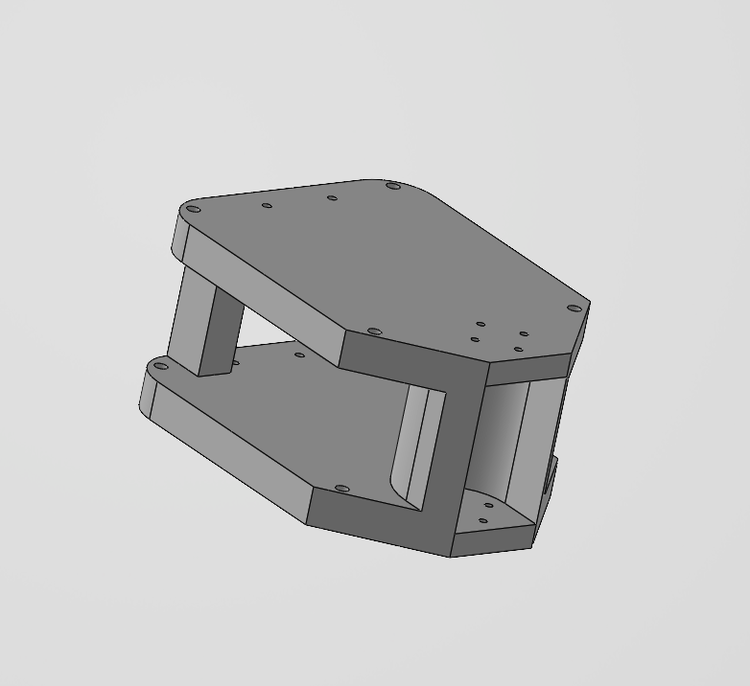
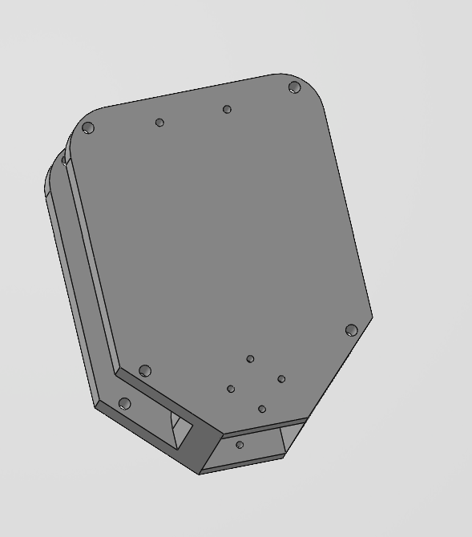
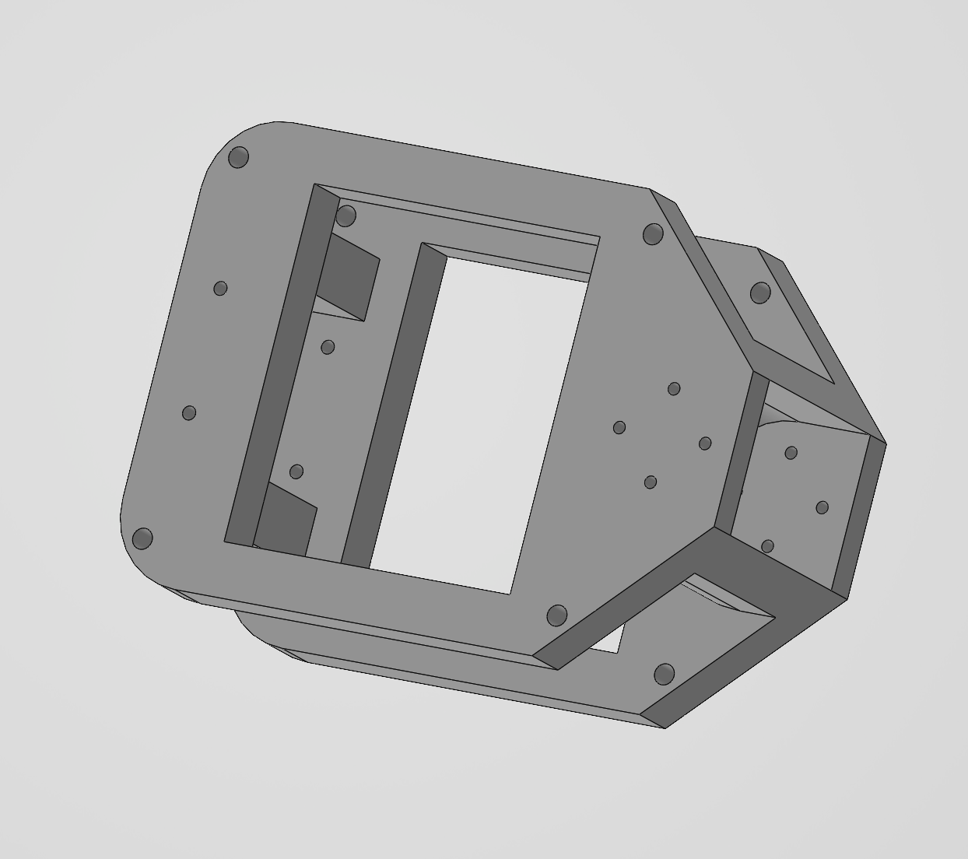
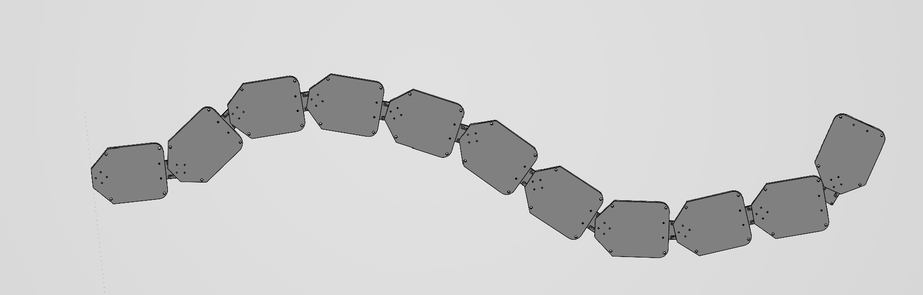


ASSEMBLY FLOW
③ Full Assembly
Motor → Segment Parts → Full Chain Assembly
CAD DESIGN DEVELOPMENT
A Segment Designed Around the Motor
The CAD model is built to the exact dimensions of the Dynamixel XL330-M288 servo, using a modular, segment-based architecture focused on manufacturability and scalability.
DESIGN CONSIDERATIONS
Motor mounting — Precise seats for XL330 servo bodies.
Structural rigidity — Stiff frame to resist motion loads.
Cable routing — Clean daisy-chain channels for wiring.
Electronics ready — Space reserved for future boards.
① Motor
② Segment Parts
③ Full Assembly
Notes:
CAD modelled to real XL330 dimensions so printed parts mate with the actual servos. Replace the placeholder with CAD screenshots.

Slide 8
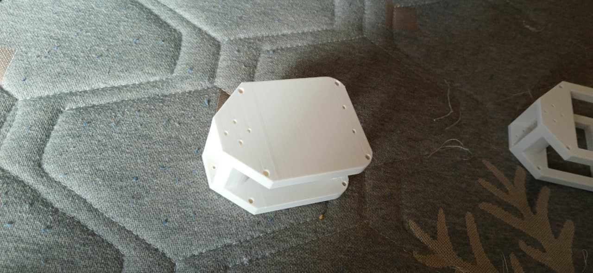



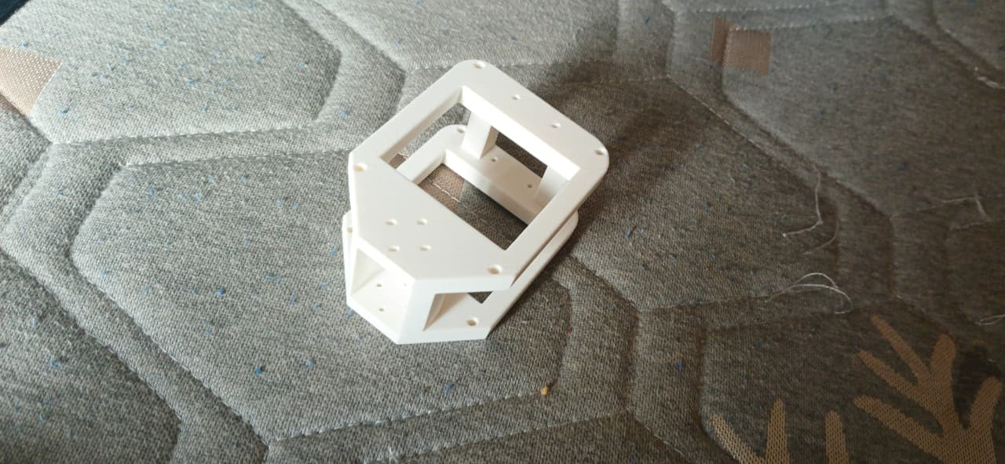


PROTOTYPE FABRICATION
From Model to Printed Hardware
FABRICATION STATUS
Two prototype segments 3D printed
DONE
Both segments produced from the CAD model.
PRINTED SEGMENT — PHOTO 1
Insert photo of the first 3D-printed segment
Initial dimensional verification done
DONE
Printed parts measured against design specs.
Physical validation of CAD initiated
NEXT
Checking fit, tolerances and assembly.
PRINTED SEGMENT — PHOTO 2
Preparing for motor-integration tests
NEXT
Insert photo of the second segment / assembly
Next: seat XL330 servos into segments.
Notes:
Two segments printed and measured, validating the CAD. Next step is servo integration. Drop prototype photos on the left.

Slide 9
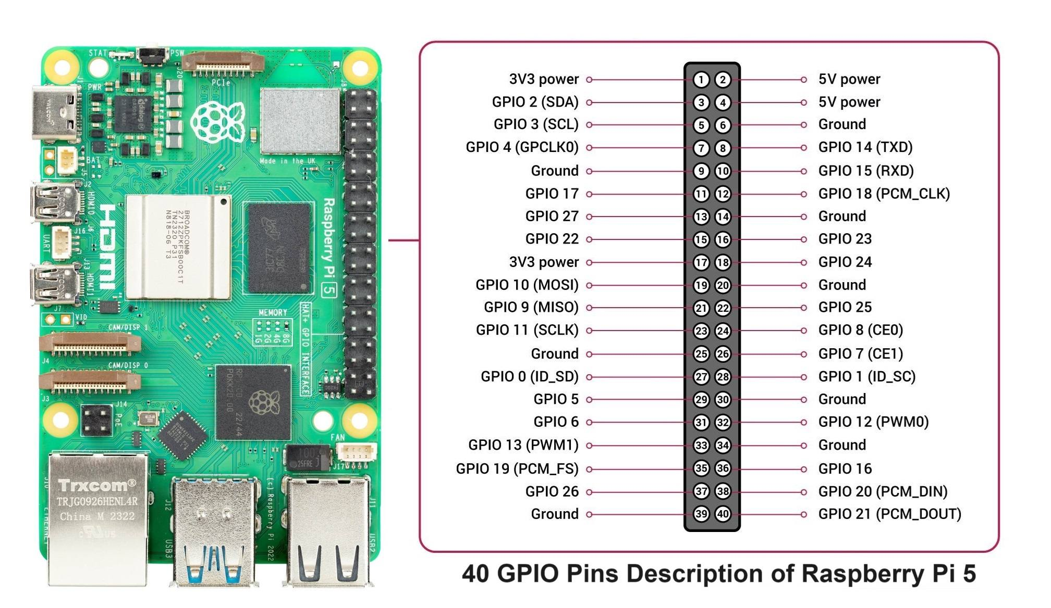


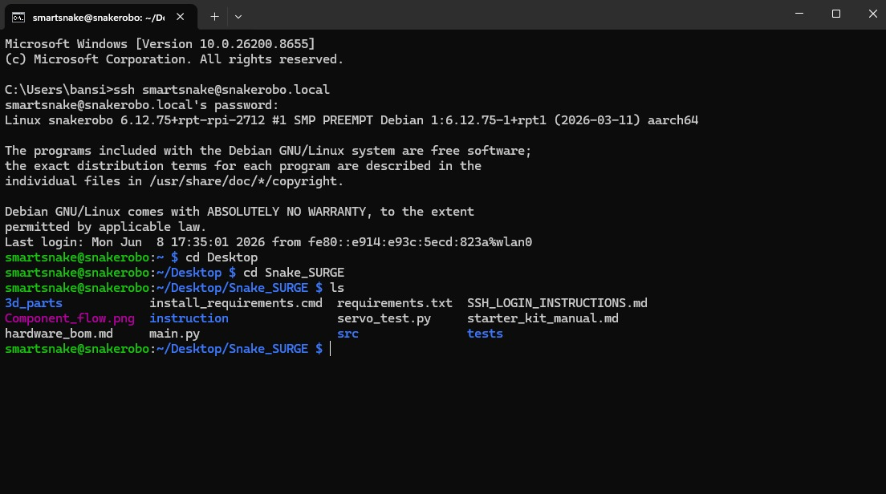
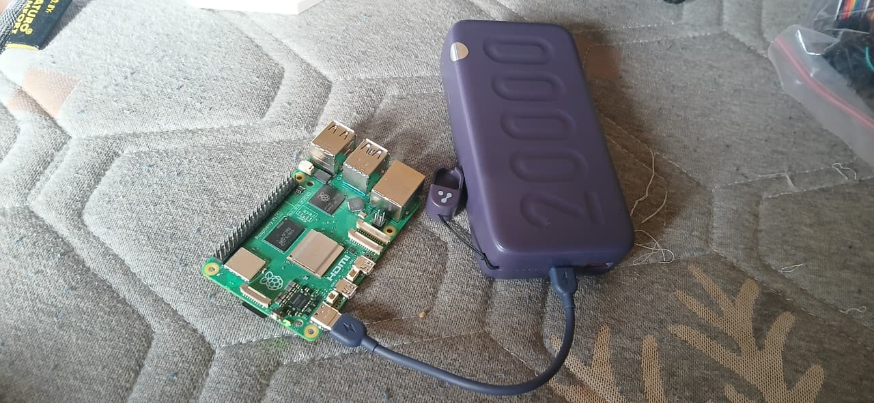


RASPBERRY PI LEARNING & DEVELOPMENT
Standing Up the Compute Platform
PROGRESS MILESTONES
Development Environment Setup
Raspberry Pi 5 received & configured
Raspberry Pi OS installation completed
Wi-Fi connectivity established
Raspberry Pi OS Desktop
GPIO / Python Testing
SSH & remote access explored
Basic GPIO & intro projects performed
SSH Remote Access
System Configuration
Raspberry Pi Platform Successfully Configured and Tested
Linux environment & Python familiarity
Notes:
Control computer is live: OS installed, networked, remotely accessible, exercised with intro GPIO and Python. De-risks software before motors arrive.

Slide 10
HARDWARE PROCUREMENT & RESOURCE AVAILABILITY
Hardware Procurement & Resource Availability
Hardware Strategy: Raspberry Pi 4 was planned in the BOM; however, a Raspberry Pi 5 was already available in the laboratory, enabling immediate software development and testing without waiting for delivery. To accelerate development, the team utilised the laboratory Raspberry Pi 5 platform while the ordered components remain under procurement.
AVAILABLE & IN USE
ORDERED — AWAITING DELIVERY
COMPLETED PREPARATORY WORK
Raspberry Pi 5 (Laboratory Resource)
Raspberry Pi Starter Kit
Raspberry Pi OS Environment
GitHub Repository
3D Printed Prototype Segments
Dynamixel XL330 Smart Servo Motors
U2D2 Communication Interface
U2D2 Power Hub Board
Dynamixel Communication Cables
5V Power Supply
ESP32 Development Board
Hardware selection finalised
Bill of Materials prepared
CAD model completed
Segment fabrication initiated
Software environment configured
DEVELOPMENT PROGRESS
✓
✓
✓
✓
✓
⏳
→
Component
Selection
Procurement
Initiated
CAD
Design
Prototype
Printing
RPi
Learning
Motor
Integration
Locomotion
Testing
Awaiting HW
Upcoming
★
Key Achievement: Although the primary Dynamixel hardware has not yet arrived, the team has successfully utilised available laboratory resources to complete design, fabrication, documentation, and software preparation activities, ensuring project progress is maintained.
Notes:
Live BOM from the purchasing sheet. Compute hardware in hand; actuation and power chain ordered. Total approx Rs 33,760.

Slide 11
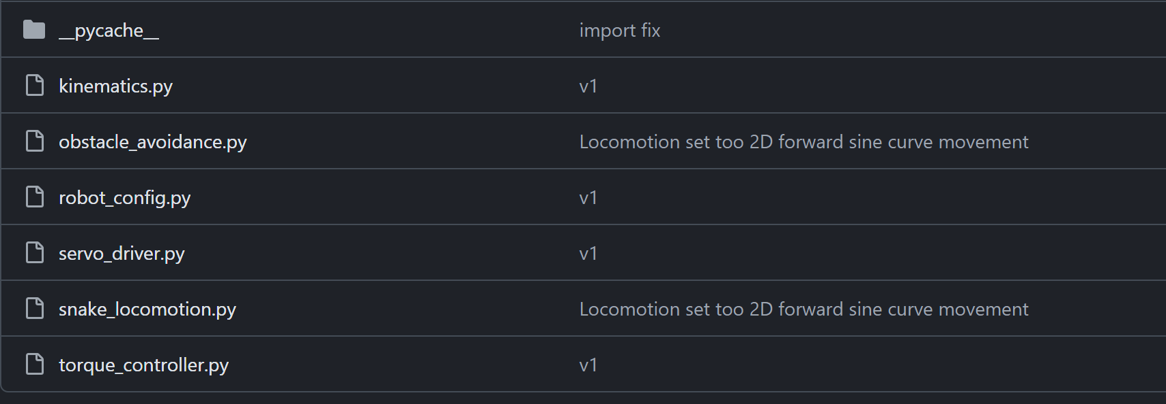
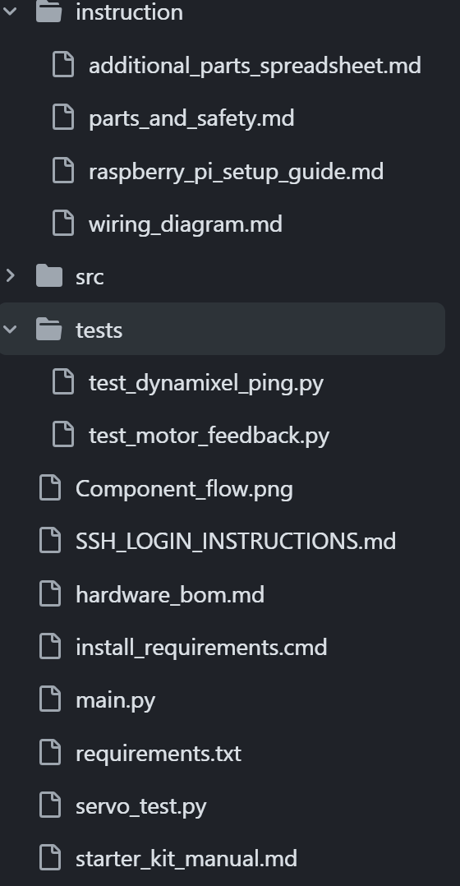
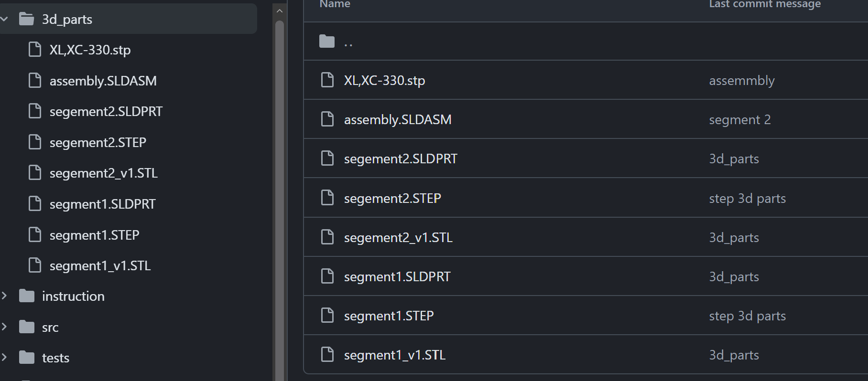
REPOSITORY & DOCUMENTATION
Version Control From Day One
Repository created
Central home for the whole project.
GITHUB REPOSITORY SCREENSHOTS
1
Version control established
Tracked, reversible change history.
2
CAD files uploaded
Design source committed to the repo.
3
GitHub repository — project root & structure
Design iterations documented
Every revision captured in commits.
4
Progress tracking in place
Milestones and issues logged.
5
Commit history — tracked iterations & uploads
Team collaboration workflow
Shared branches and pull requests.
6
✓ All milestones tracked in GitHub
Notes:
The repo is the single source of truth — CAD, docs, tracked iterations — with a collaboration workflow already running.

Slide 12
PROJECT TIMELINE
Eight Phases · Currently at 25%
PHASE 1
PHASE 3
PHASE 5
PHASE 7
Research & Design
Mechanical Assembly
Control Algorithms
Testing & Optimisation
Completed
Up next
1
2
3
4
5
6
7
8
PHASE 2
PHASE 4
PHASE 6
PHASE 8
Hardware Procurement
Motor Integration
Sensor Integration
Final Demonstration
In progress
WE ARE HERE
Notes:
Eight-phase plan: Phase 1 complete, Phase 2 active, Phase 3 next — about 25%. Phases 4-8 cover integration, control, sensing, testing, demo.

Slide 13




CURRENT ACHIEVEMENTS
Concrete Wins in Quarter One
Architecture finalized
CAD design completed
Prototype fabrication started
System block diagram locked.
Segment modelled to motor specs.
Two segments printed & checked.
Pi environment established
GitHub workflow operational
Procurement initiated
OS, network and tooling ready.
Version control and docs live.
Core compute received; rest ordered.
Notes:
Six headline achievements: design, fabrication, compute, tooling and procurement all moving — a working foundation.

Slide 14
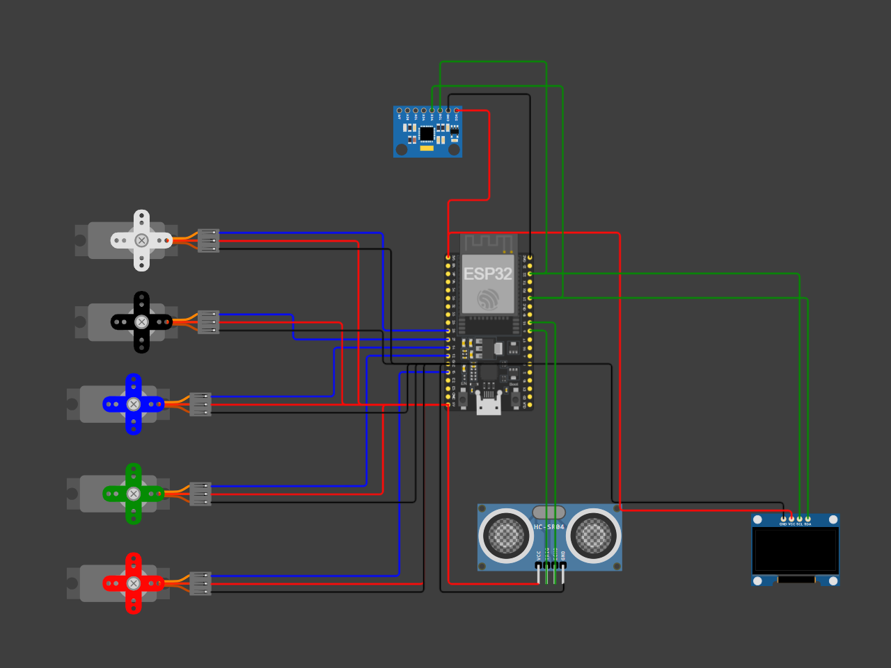
SIMULATION & VALIDATION
Simulation-Based Validation of Control Architecture
SIMULATION OBJECTIVE
A virtual testing platform to validate the control architecture before Dynamixel actuators and communication hardware arrive — enabling software development, algorithm verification, and sensor integration in parallel with procurement.
COMPONENTS SIMULATED
Controller
Sensors
Display
Actuators
ESP32 · 5-Servo joint network · MPU6050 IMU · HC-SR04 ultrasonic · SSD1306 OLED · control & communication framework
FUNCTIONAL VALIDATION COMPLETED
Multi-joint servo coordination
Travelling-wave serpentine gait generation
Obstacle detection via ultrasonic sensing
IMU integration for orientation feedback
OLED-based system status monitoring
Sensor–controller–actuator communication
ENGINEERING BENEFITS
Reduced dependence on hardware delivery timelines
Enabled early software debugging & control-architecture verification
Established migration path to Raspberry Pi 5 + Dynamixel XL330, reducing integration risk
Wokwi-based simulation environment developed to validate locomotion control, sensor integration, and communication architecture before physical Dynamixel hardware arrival.
KEY OUTCOME A complete software-validation framework was developed, allowing locomotion, sensing, and control workflows to be tested before physical robot assembly.

Slide 15
FUTURE WORK & DEVELOPMENT ROADMAP
Planned Activities for the Next Development Phase
1
Hardware Arrival
2
Mechanical Assembly
3
Communication Setup
4
Locomotion Development
5
Sensor Integration
6
Testing & Optimization
Receive Dynamixel XL330 motors
Receive U2D2 interface
Verify purchased components
Assemble complete snake body
Install Dynamixel actuators
Route communication cables
Configure motor IDs
Establish serial communication
Validate daisy-chain architecture
Port simulation code to Pi 5
Implement serpentine locomotion
Synchronize multi-joint movement
Integrate MPU6050 IMU
Integrate obstacle detection
Implement feedback control
Motion performance testing
Power & reliability analysis
System optimization
Completed phase
Ongoing work
Future milestone
EXPECTED DELIVERABLES
TARGET FOR NEXT REVIEW
Fully assembled snake robot
Dynamixel-based locomotion
Sensor-assisted navigation
Integrated Raspberry Pi 5 control system
Demonstration-ready prototype
Final SURGE project showcase
Complete hardware integration
Demonstrate basic snake locomotion
Validate communication architecture
Validate sensing framework
Goal: ~60–70% project completion

